Slide 1
Claude Code
Lecturer: Ngo Huy Bien
Software Engineering Department
Faculty of Information Technology
VNUHCM - University of Science
Ho Chi Minh City, Vietnam
nhbien@fit.hcmus.edu.vn

Slide 2

Objectives

Slide 3

Contents
Claude Code.

Slide 4

References

Slide 5
1. Buy Claude Pro Plan
https://claude.com/pricing

Slide 6
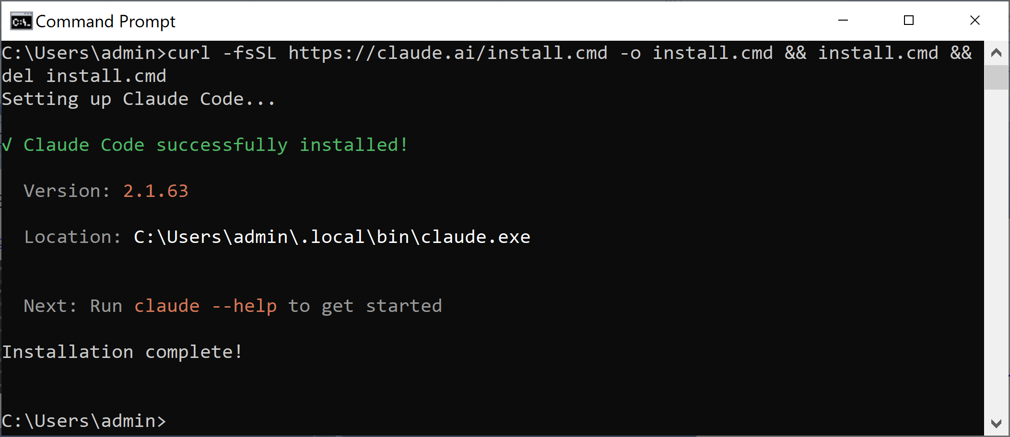
2. Install Claude Code on Windows
https://code.claude.com/docs/en/quickstart
curl -fsSL https://claude.ai/install.cmd -o install.cmd && install.cmd && del install.cmd

Slide 7
3. Remove Claude Code on Windows
https://code.claude.com/docs/en/setup#windows-powershell-5
Remove-Item -Path "$env:USERPROFILE\.local\bin\claude.exe" -Force
Remove-Item -Path "$env:USERPROFILE\.local\share\claude" -Recurse -Force
del "%USERPROFILE%\.claude.json"
del "%USERPROFILE%\.claude.json.backup"

Slide 8
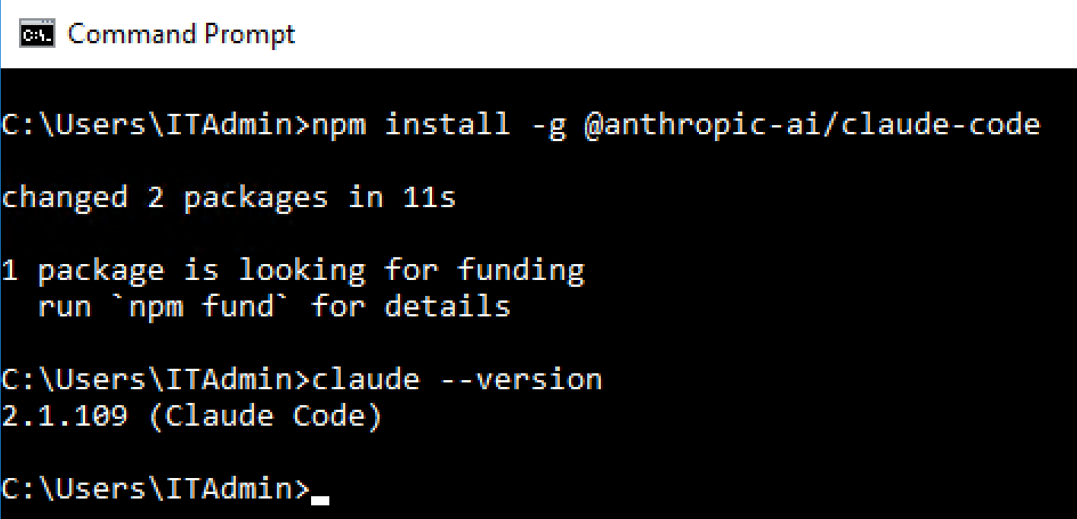
4. Install Claude Code on Server 2016
node --version
npm --version
python --version
npm install -g @anthropic-ai/claude-code
claude --version

Slide 9
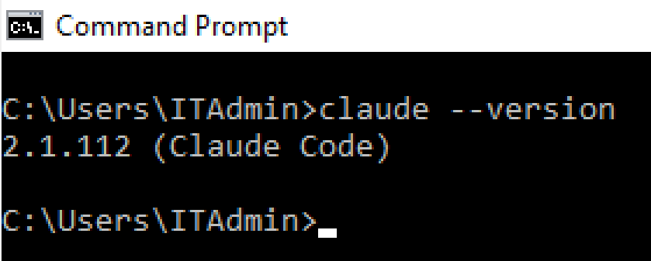
5. Uninstall Claude Code on Server 2016
npm uninstall -g @anthropic-ai/claude-code
npm install -g @anthropic-ai/claude-code@2.1.112

Slide 10
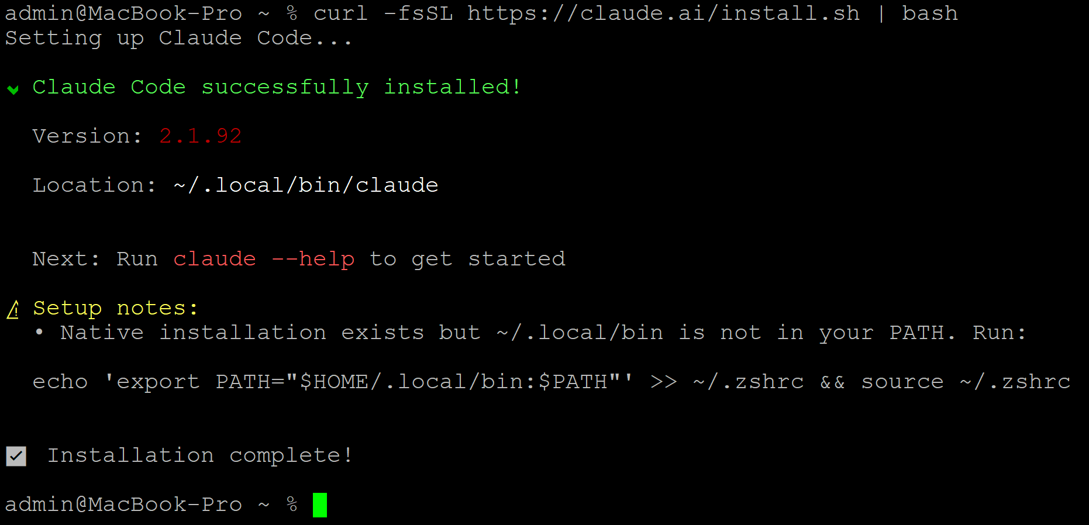
6. Install Claude Code on macOS
https://code.claude.com/docs/en/quickstart
curl -fsSL https://claude.ai/install.sh | bash
echo 'export PATH="$HOME/.local/bin:$PATH"' >> ~/.zshrc && source ~/.zshrc

Slide 11


Slide 12
1. Open Claude Code
cd C:\Users\admin\Downloads\inventory
claude

Slide 13
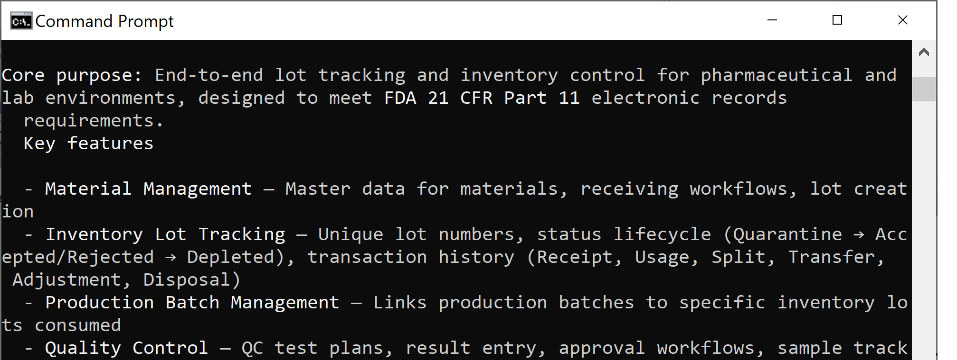
2. Ask a Question
what does this project do?

Slide 14
3. Add a Feature
create UI for the login feature.

Slide 15
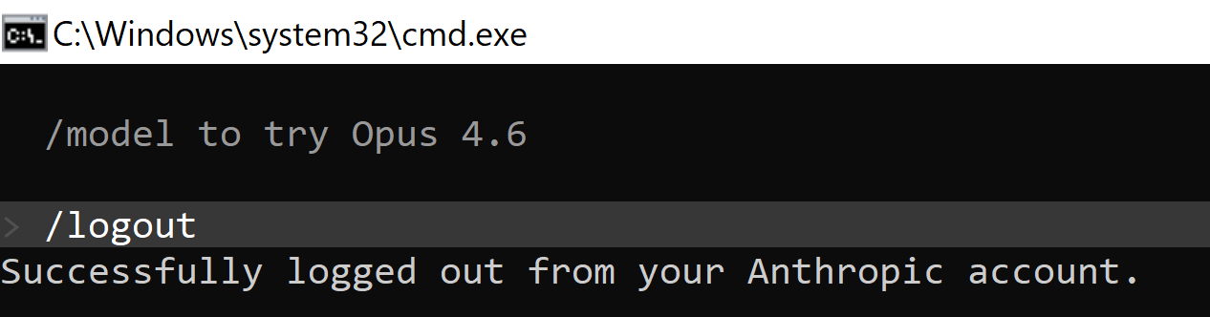
4. Log out Claude Code
claude
/logout

Slide 17
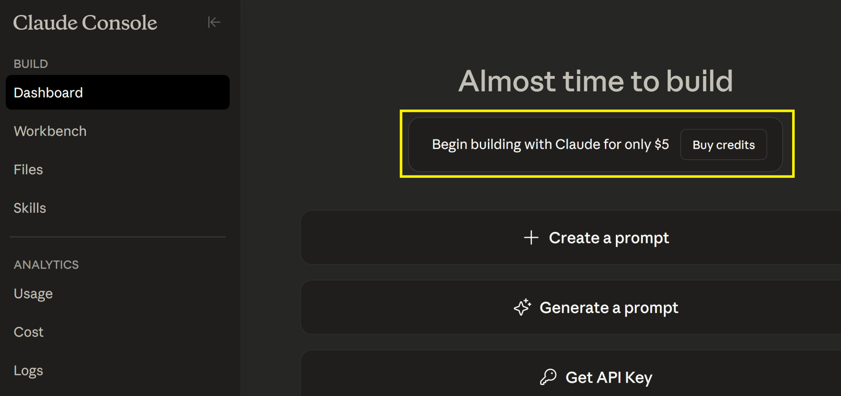
1. Buy Claude Credits
https://platform.claude.com/dashboard

Slide 18
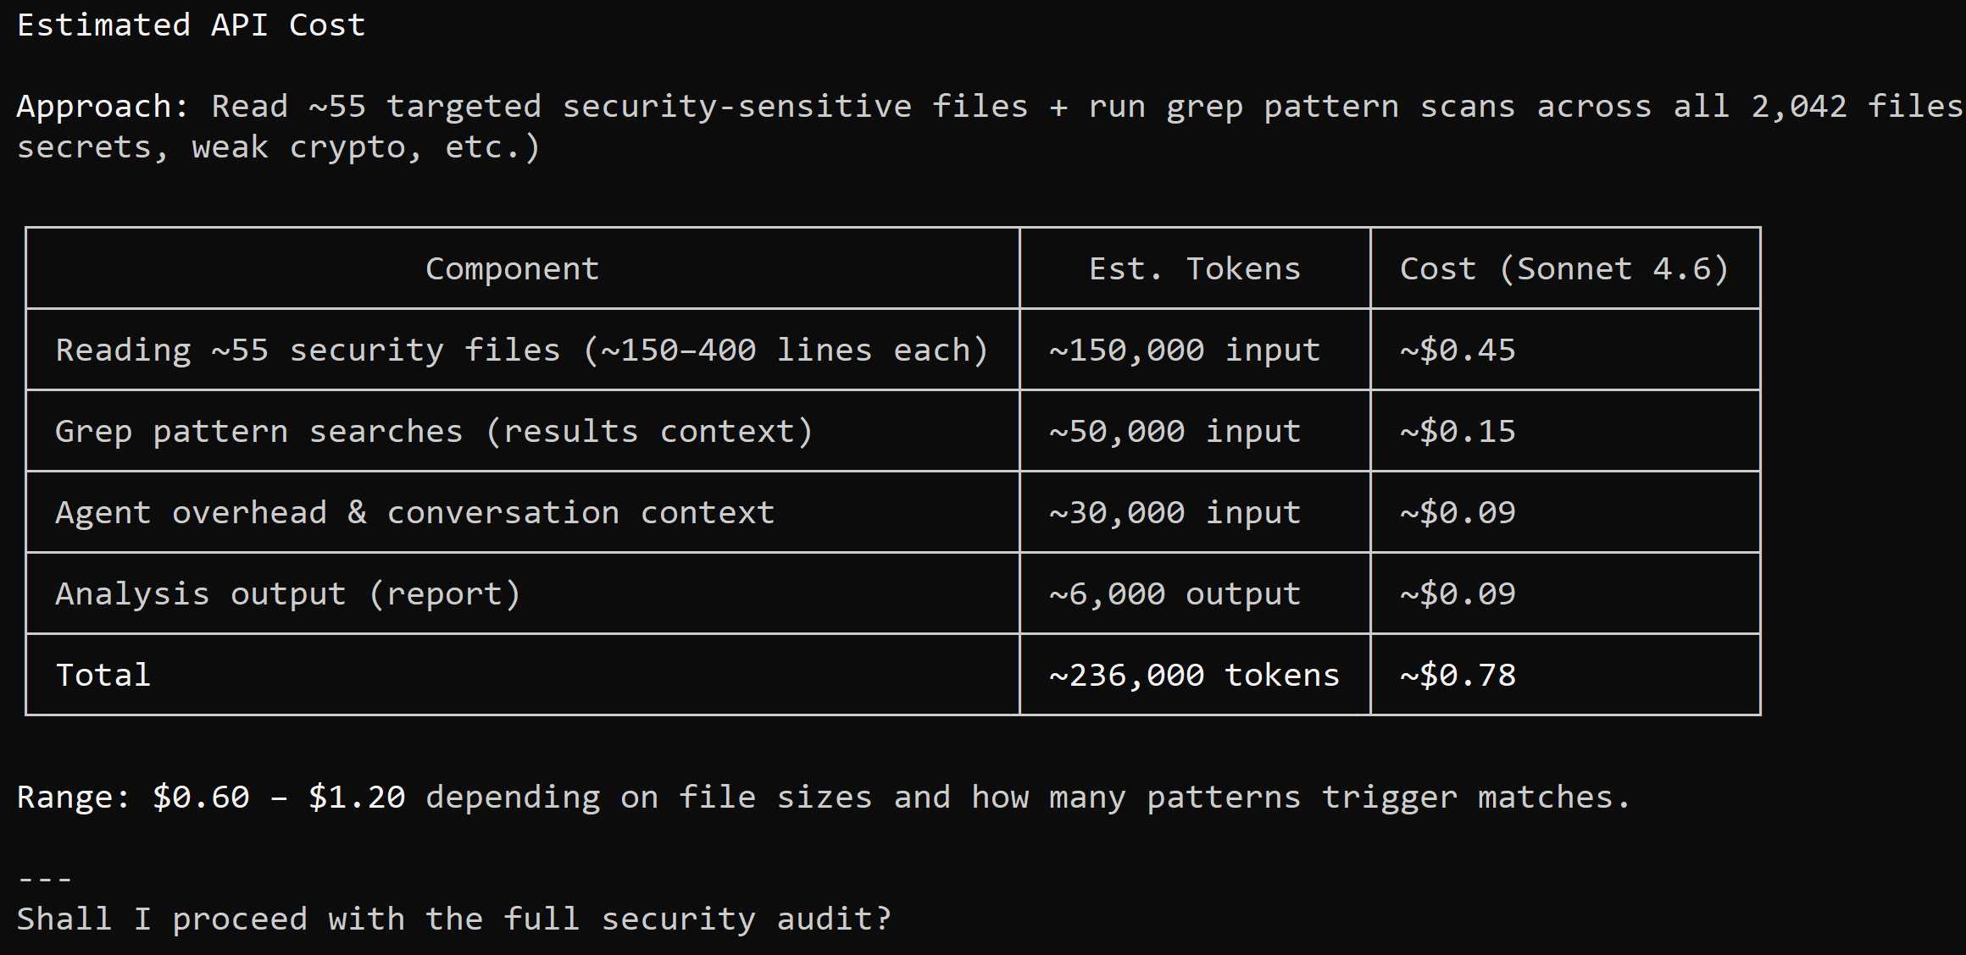
2. Scan Security Vulnerabilities
Check for security vulnerabilities in the source code. Search through all folders, but only analyze .NET code files. Then give me estimated API cost before proceeding.

Slide 19
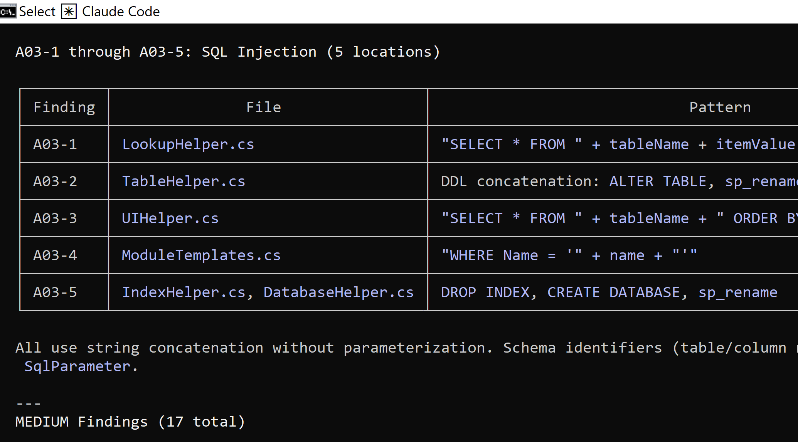
3. Review the Result

Slide 20
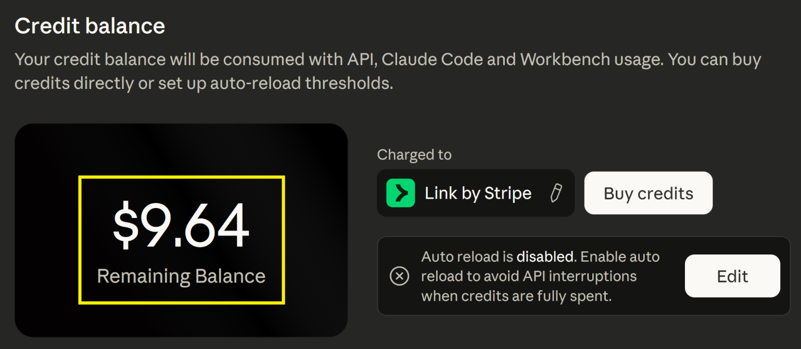
4. Review Credit Balance
https://platform.claude.com/settings/billing

Slide 21
5. Use Azure Model
https://code.claude.com/docs/en/microsoft-foundry

Slide 23
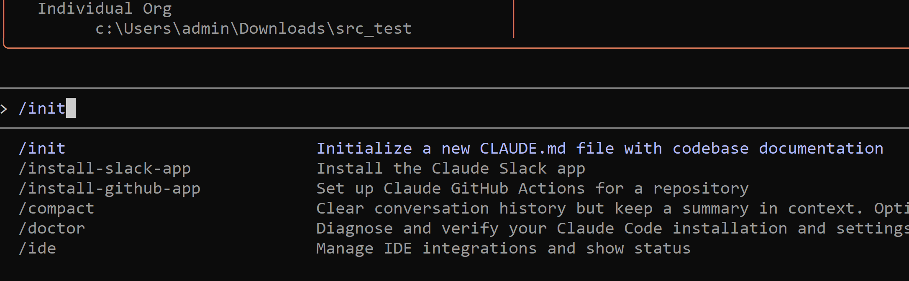
1. Let Claude Code learn your project
> /init
Claude will create a CLAUDE.md file that captures how your project works—build commands, testing setup, best practices.

Slide 24
2. Commit the CLAUDE.md file
> Use github CLI to commit the CLAUDE.md file
> Commit and push this change

Slide 25
3. Enable Web Search Tool
https://platform.claude.com/docs/en/agents-and-tools/tool-use/web-search-tool

Slide 27
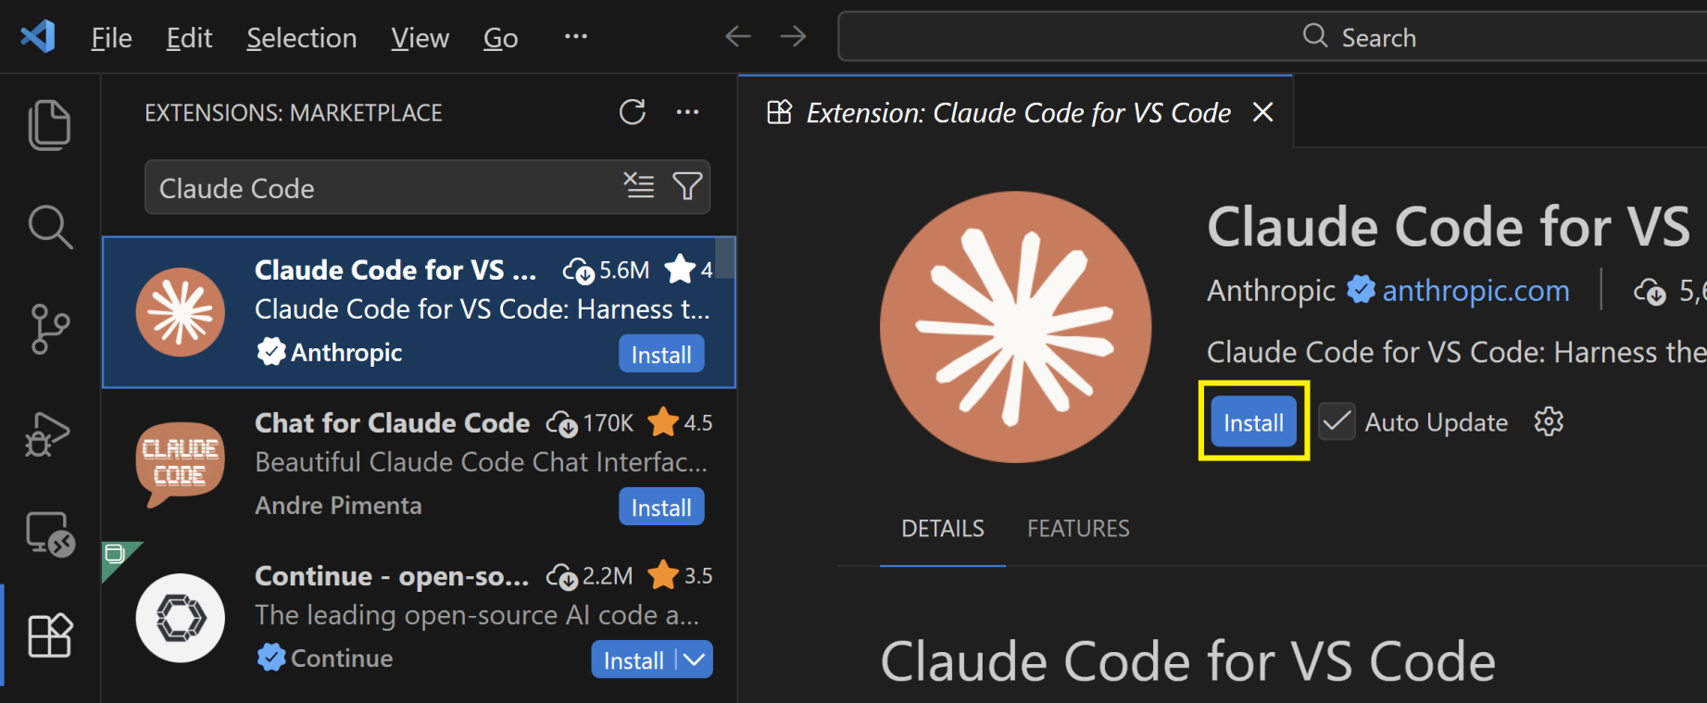
1. Install Claude Code for VS Code

Slide 28
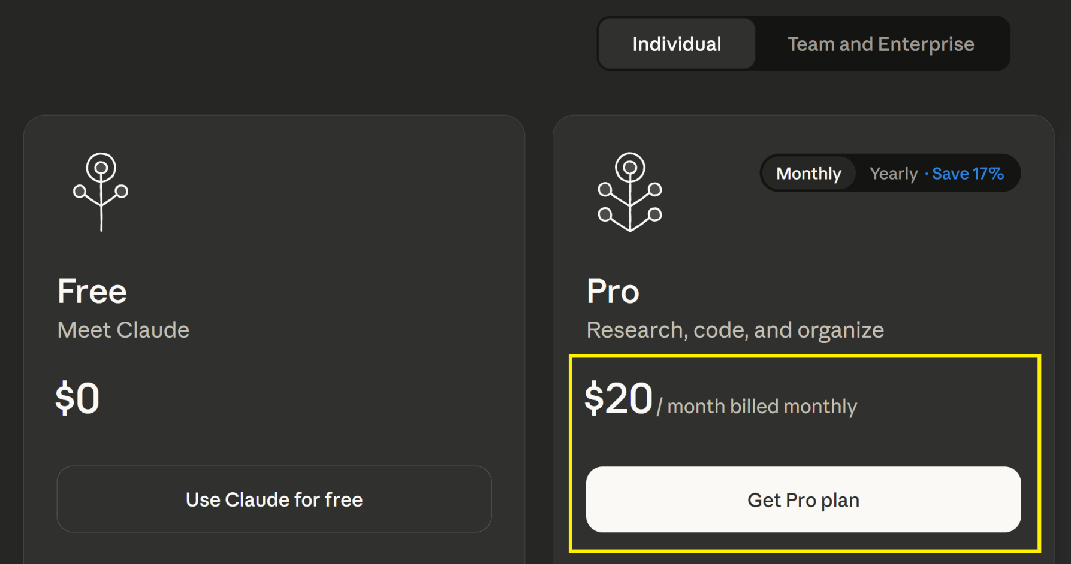
2. Purchase a Pro Plan
https://claude.ai/upgrade

Slide 29
3. Set Up Git
Add these directories at the top in the system PATH.
C:\Program Files\Git\usr\bin C:\Program Files\Git\bin
where bash
Expected: C:\Program Files\Git\usr\bin\bash.exe
bash --version
Expected output: GNU bash, version X.X.X
setx CLAUDE_CODE_GIT_BASH_PATH "C:\Program Files\Git\usr\bin\bash.exe"
Restart your computer.
echo %CLAUDE_CODE_GIT_BASH_PATH%

Slide 30
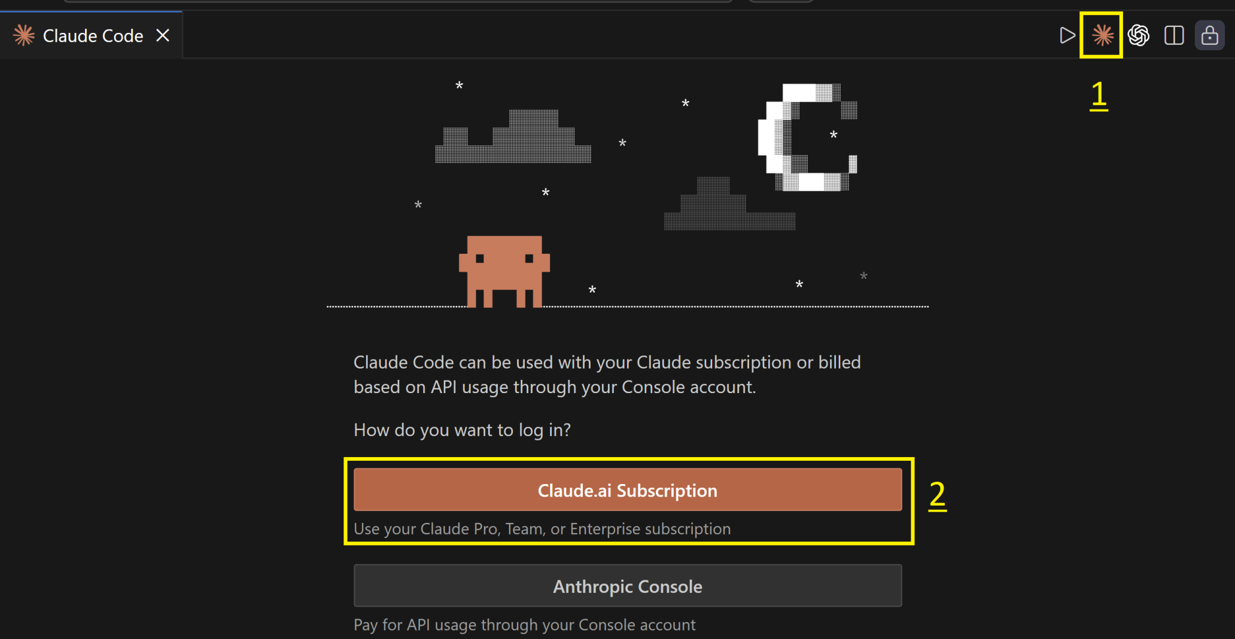
4. Set Up Claude Code

Slide 32
1. Enter Plan Mode
In Plan Mode, Claude Code explores your codebase and creates a detailed plan before editing any code.
Enter Plan Mode by pressing `shift+tab+tab`.
> Think through how to add OAuth authentication to our app. Show the architecture, files we'll need, and implementation steps. Feel free to ask me questions.

Slide 33
2. Write Tests First, then Implement
Claude Code can write comprehensive tests to catch edge cases early and give you confidence that the code works correctly.
> Write comprehensive tests for the OAuth flow - signup, login, token refresh, and error cases. Make sure they fail for now. Then, implement the OAuth system to make these tests pass.

Slide 34
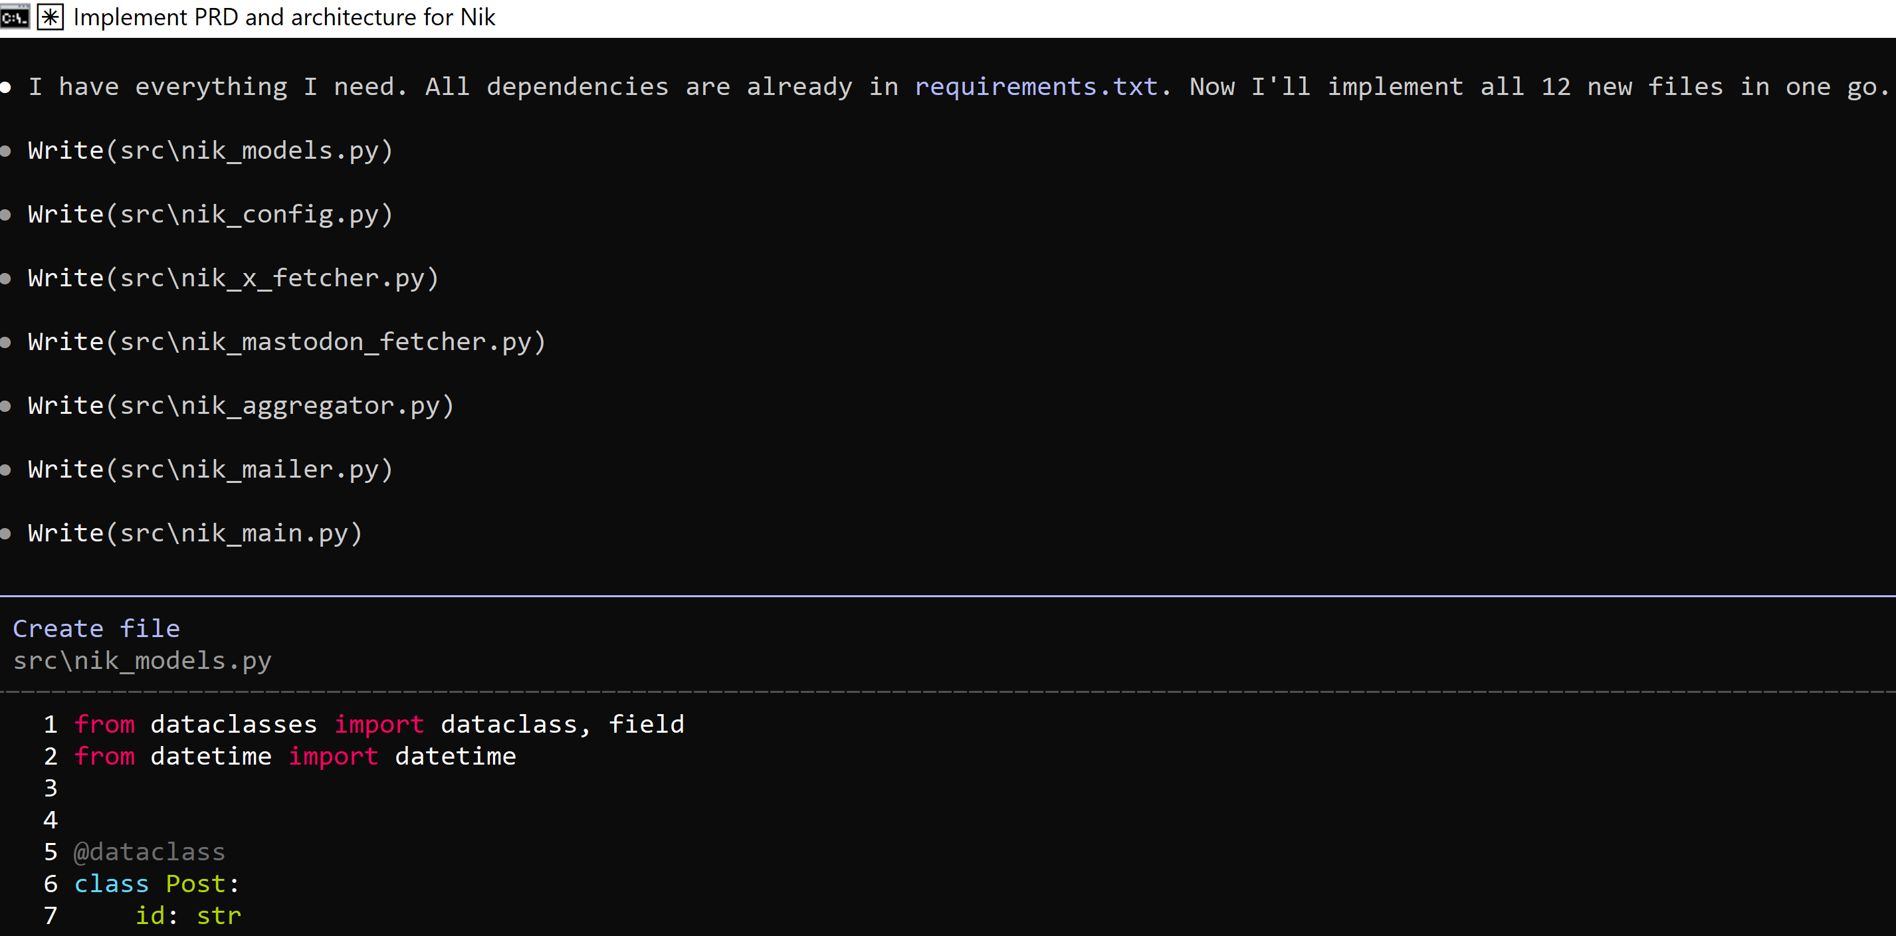
3. Apply Discipline
PRD -> Architecture -> Code.
Models -> Configurations -> Logic.

Slide 35
4. Understand What an Agent Searches For
What exactly did you search for?
Why did you search for these terms?
What if the codebase uses different conventions?

Slide 36
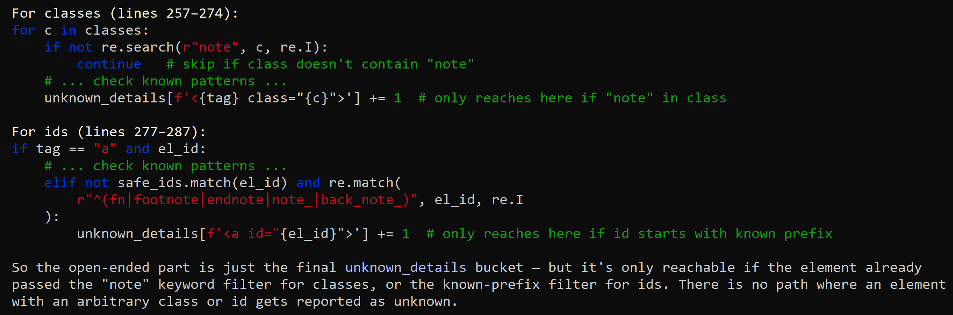
5. Understand Open-Ended Search
How will you conduct an open-ended search?
How will you identify class names that suggest notes, footnotes, or references?
How will you identify which HTML pages appear to be footnote-only pages rather than main content pages, based on their content length and structure?

Slide 37
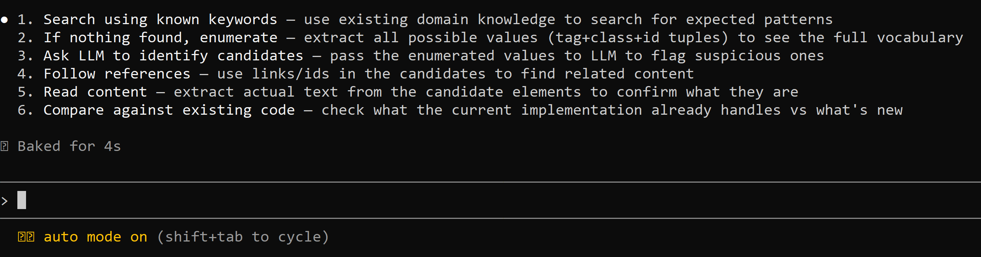
6. Understand Better Open-Ended Search Strategy
Ask the LLM for keywords to use in the search.
Ask the LLM for search query combinations.
Ask the LLM to identify patterns in the search results that relate to the problem.
Ask the LLM what to do with results that contain candidate patterns.

Slide 38
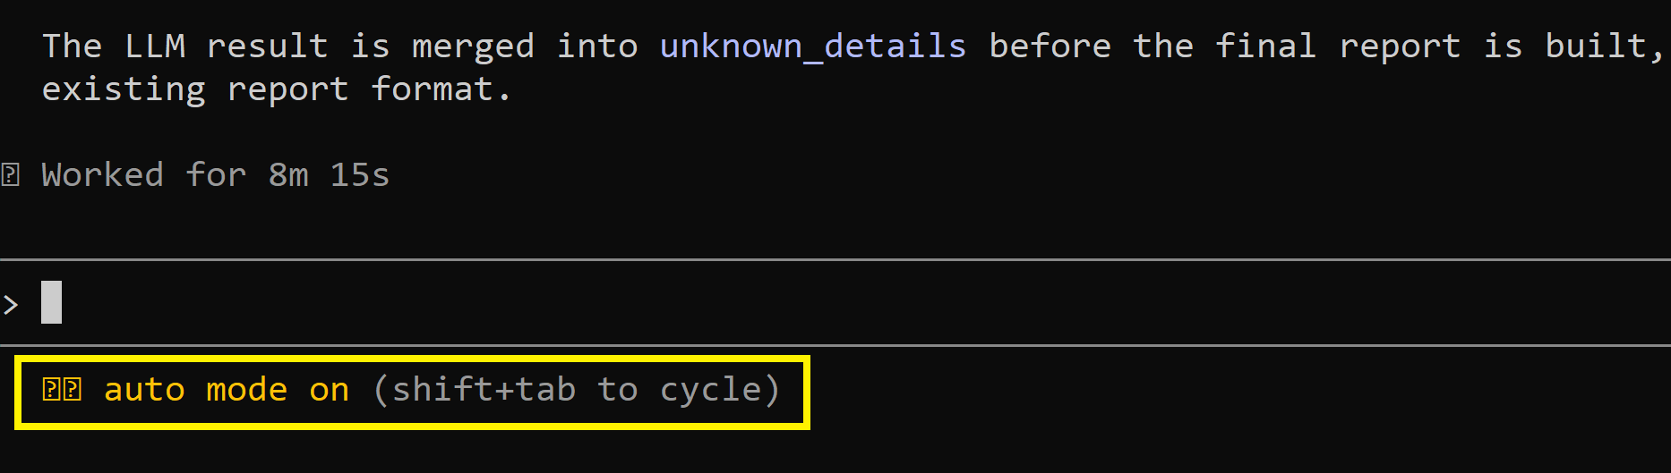
7. Enable Auto-accept Mode
Once Claude Code is on the right track, hit `shift+tab` to let Claude Code autonomously edit files in your directory.
Pro tip: You can send messages anytime while Claude works and Claude adjusts course immediately.

Slide 40
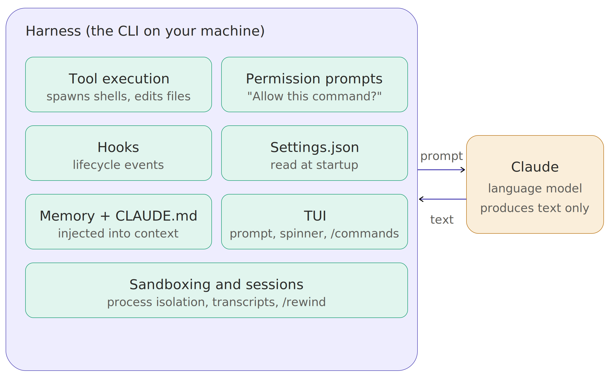
The Harness
TUI stands for Text-based User Interface (sometimes called Terminal User Interface).

Slide 41
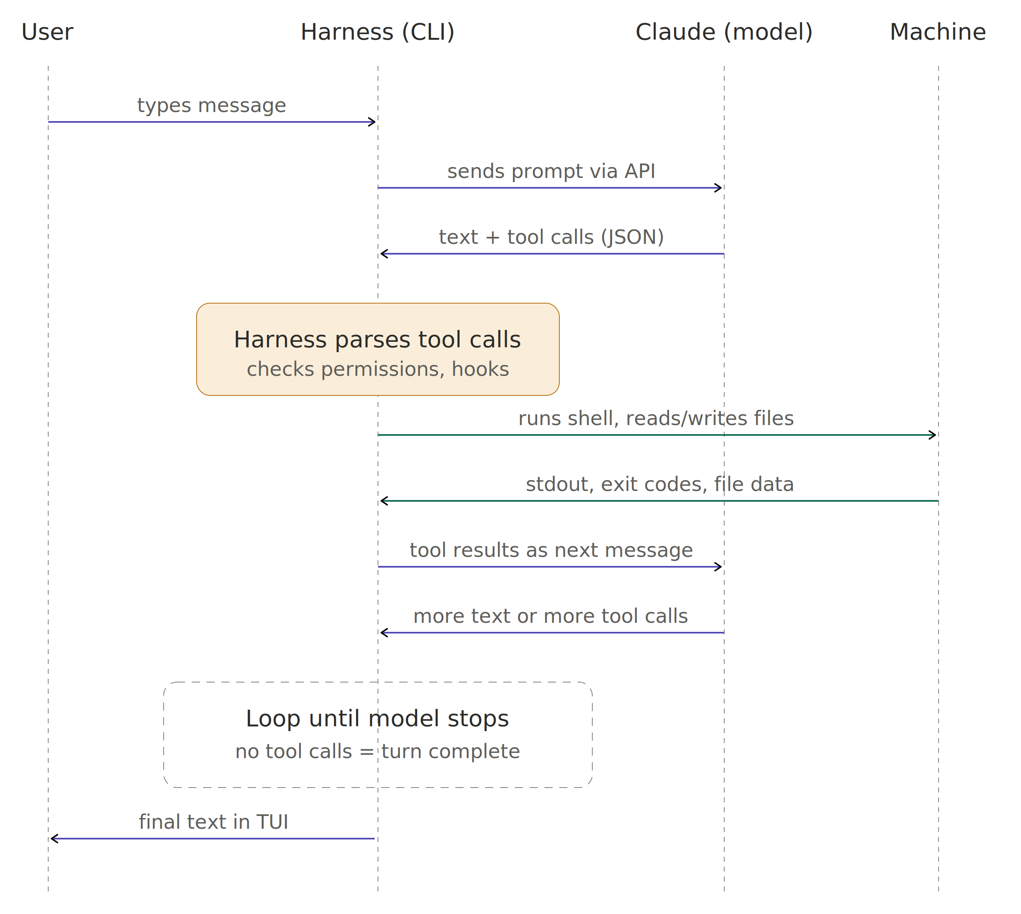
The Harness and Model

Slide 42
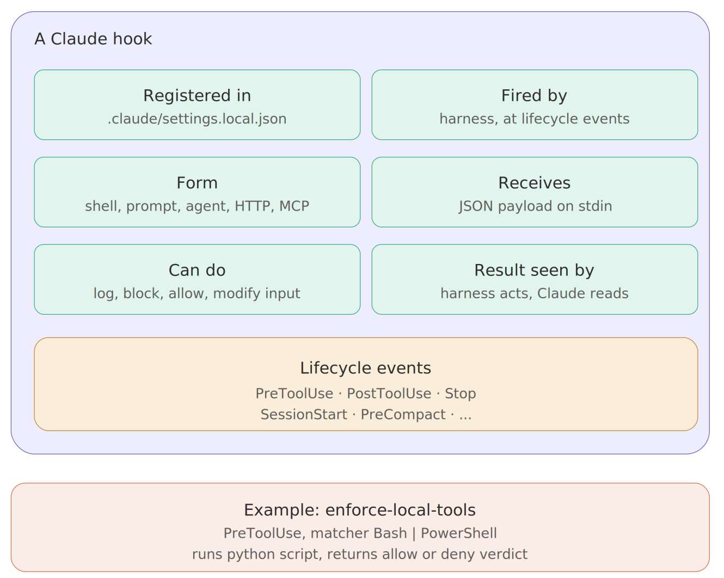
Hooks

Slide 43
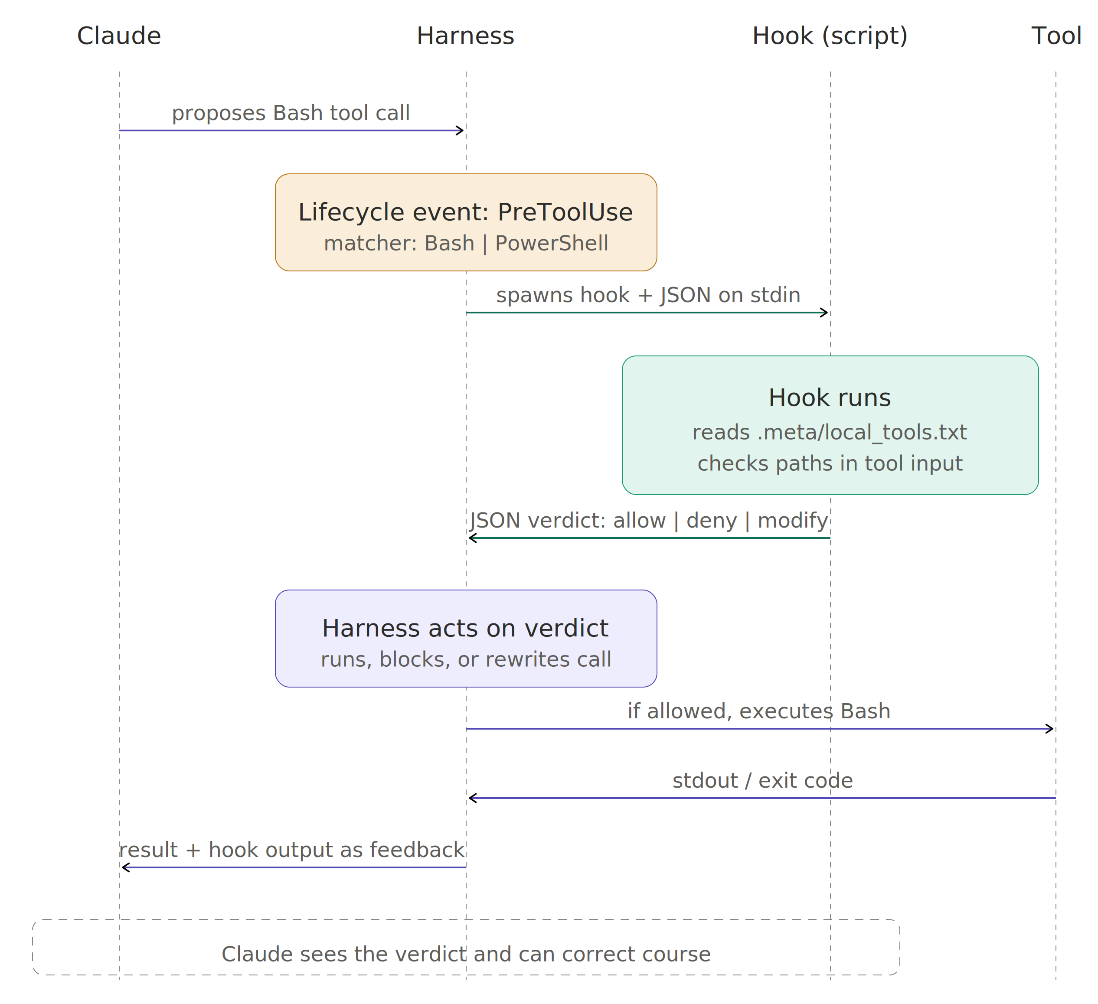
The Harness and Hooks

Slide 44
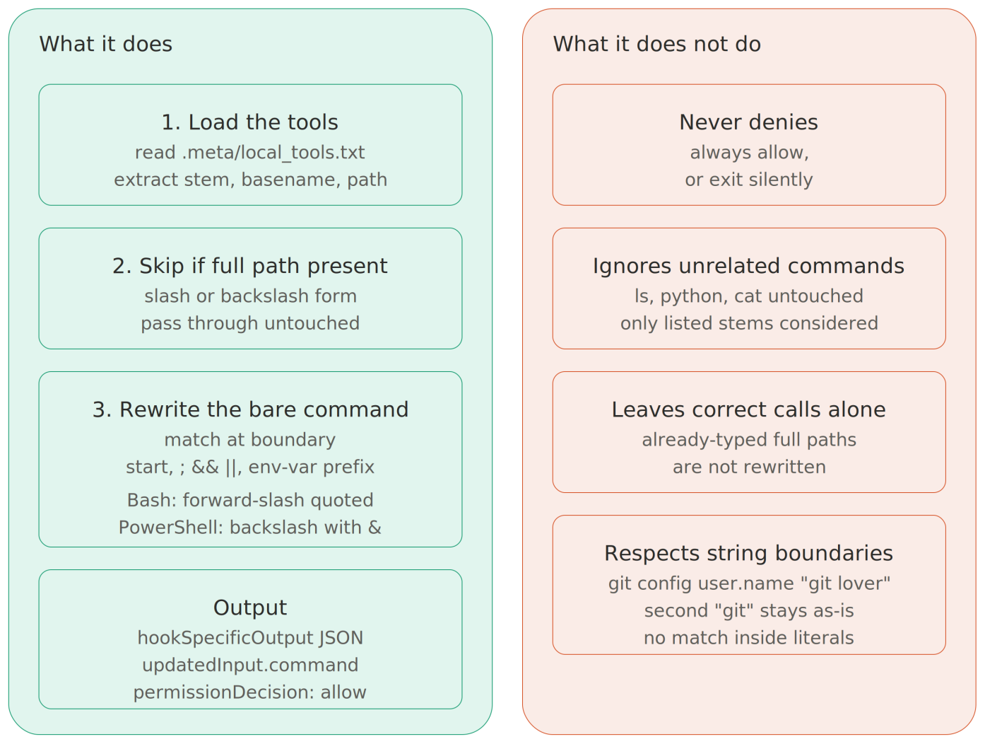
Example Hook Enforcing Local Tools (I)

Slide 45
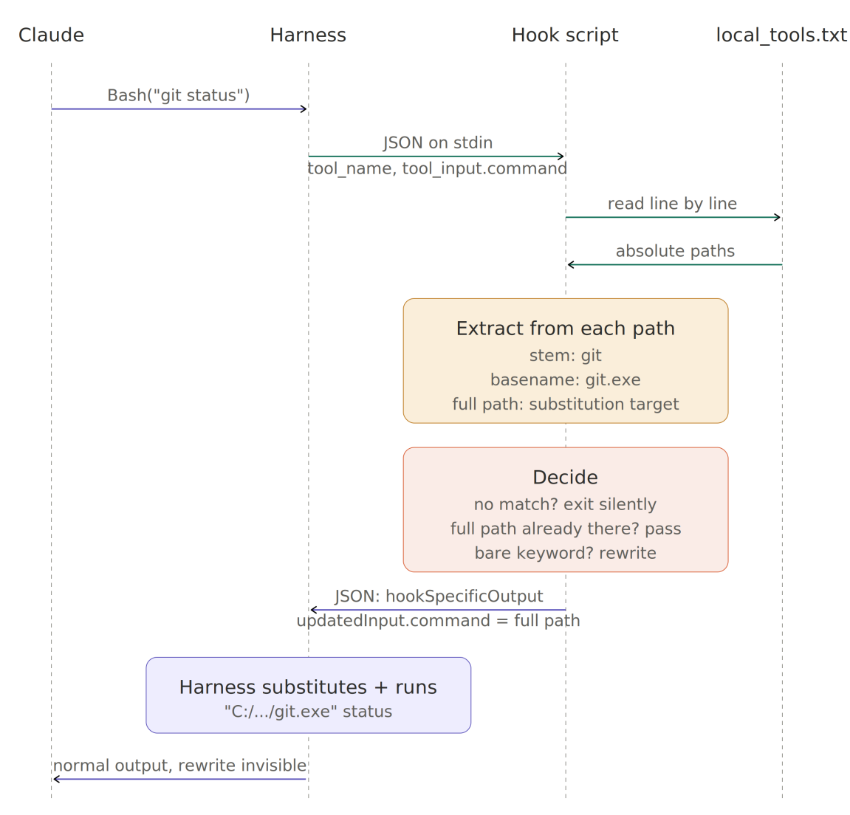
Example Hook Enforcing Local Tools (II)

Slide 47
1. Install a Skill
claude
/plugin marketplace add Imbad0202/academic-research-skills
/plugin install academic-research-skills
/reload-plugins
/academic-research-skills:ars-lit-review

Slide 48
2. Install a Viewer
npx @kimuson/claude-code-viewer
http://localhost:3000/

Slide 49
3. Add Maintainability Sensors
https://martinfowler.com/articles/sensors-for-coding-agents.html
https://github.com/birgitta410/sensors-cli
Internal quality problems affect AI agents in similar ways that they affect human developers.
An agent working in a tangled codebase might look in the wrong place for an existing implementation, create inconsistencies because it has not noticed a duplicate, or be forced to load more context than a task should require.

Slide 51
Chat vs. Cowork vs. Claude Code
Chat is for quick questions, brainstorming, iterative drafting, and working through problems back and forth.
Cowork is for complex or sustained work—research, analysis, and producing finished documents and deliverables—where Claude needs room to pull from multiple sources and see things through.
Cowork = desktop app + local files + connectors + browser control + computer use + autonomous multi-step execution + scheduling + mobile dispatch. Mobile dispatch lets you kick off or steer a Cowork task from your phone, while the actual work runs on your desktop.
Web chat answers questions turn-by-turn with your uploaded files and connectors, while Cowork takes a goal and autonomously executes multi-step work across your local files, apps, browser, and connectors on the desktop.
Claude Code is for building software—writing, testing, running, and deploying code, with access to your file system and development tools.

Slide 52
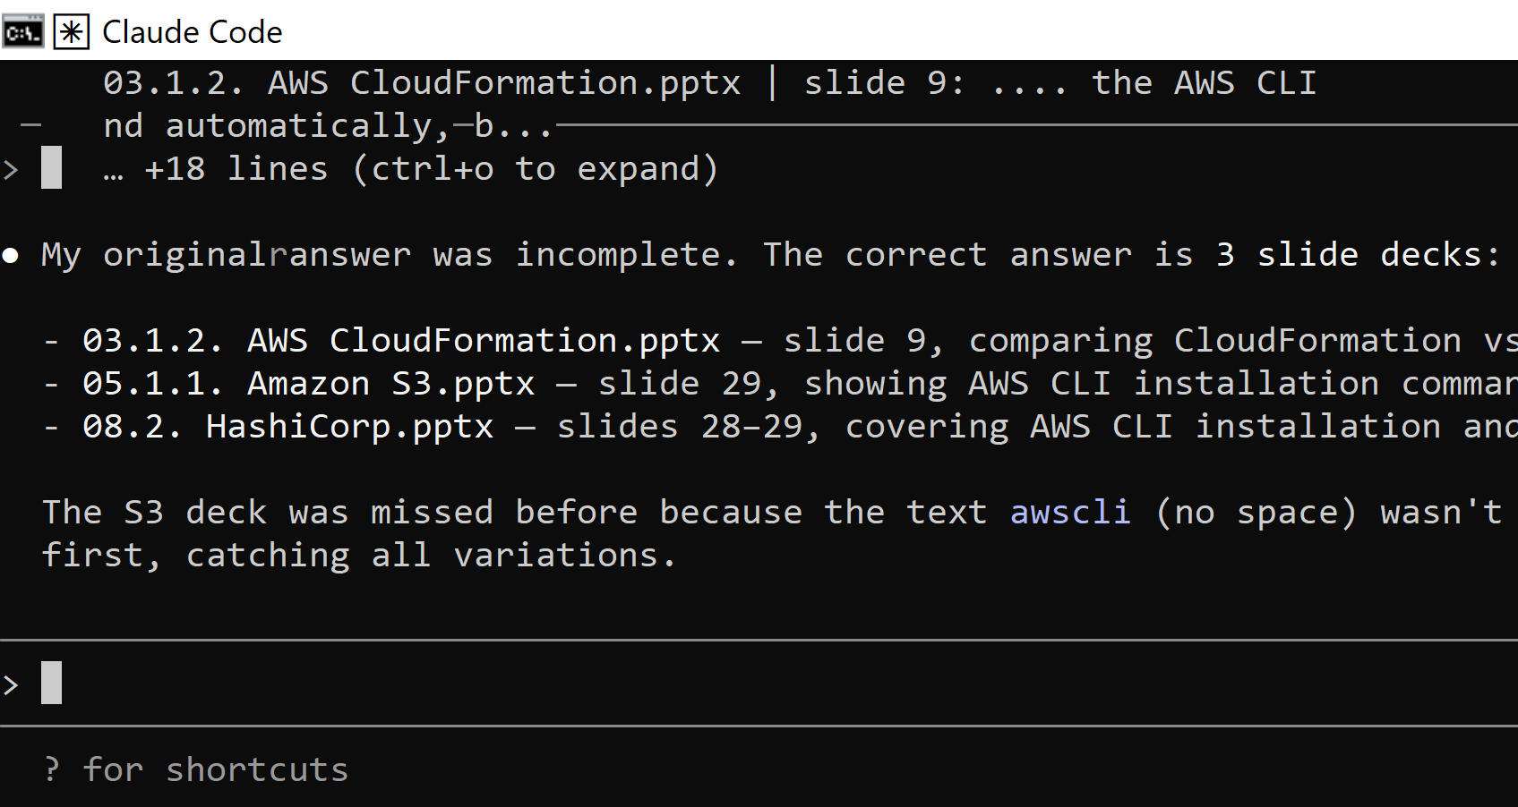
1. Use Claude Code with Documents
claude
init
Which slides mention the AWS CLI?
Are you sure?

Slide 53
2. Enable Skills for Claude Desktop
https://platform.claude.com/docs/en/agents-and-tools/agent-skills/overview

Slide 54

Thank You & See You Again

